Slide 1
Section 6.4
AP Biology

Slide 2
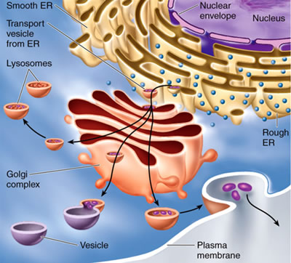
The endomembrane system
Structures Include: nuclear envelope, endoplasmic reticulum, Golgi apparatus, lysosomes, various vesicles and vacuoles, and the plasma membrane
Jobs Include: synthesis of proteins, transport of proteins into membranes and organelles or out of the cell, metabolism and movement of lipids, and detoxification of poisons

Slide 3
Endoplasmic reticulum
Biosynthetic Factory
Consists of a network of membranous tubules and sacs called cisternae
Cisternal cavity within the ER is separated from the cytosol by the ER membrane
The cisternal cavity is continuous with the cavity in the nuclear envelope

Slide 4
Endoplasmic reticulum
Rough ER has ribosomes attached to it on the cytosol side
Rough ER is closer to the nucleus than smooth ER
Cells with higher densities of Rough ER secrete proteins produced by ribosomes attached to the rough ER
Most secretory proteins are glycoproteins (proteins that have carbohydrates covalently bonded to them)
These secretory proteins are released from the cell via transport vesicles (vesicles that transport materials from one part of a cell to another)
Rough ER is also the “membrane factory” of the cell

Slide 5
Endoplasmic reticulum
Smooth ER does not have ribosomes attached to its cytoplasmic side
Serves diverse metabolic purposes
Cells that produce oils, phospholipids, and steroids (including sex hormones) are rich in smooth ER
Ex: Adrenal glands, testes, and ovaries
Cells that help detoxify drugs and poisons are also rich in smooth ER
Ex: Liver cells
Smooth ER also stores calcium ions
Ca+ ions are required for muscles contraction and as a stimulus for the secretion of certain proteins

Slide 6
The Golgi apparatus
Shipping and Receiving Center
After leaving the ER many transport vesicles go to the Golgi Apparatus
Especially extensive in secretory cells
Two sides with specific jobs
Cis face- Closer to the ER
“Receiving” portion of the GA
Vesicles move from ER to GA
Trans face- Side opposite the ER
“Shipping” portion of GA
Sends vesicles to other parts of the cell
Also manufactures some macromolecules
Contents are often modified as they travel from the cis to the trans face of the GA

Slide 7
lysosomes
Digestive Compartments
A membranous sac of hydrolytic enzymes that an animal cell uses to digest (hydrolyze) macromolecules

Slide 8
vacuoles
Diverse maintenance compartments
Different types:
Food Vacuole- formed by phagocytosis (engulfing other organisms or smaller food particles from outside the cell) fuses with lysosome to digest contents
Contractile Vacuole- pump excess water out of the cell. Essential for proper ion concentrations
Central Vacuole- (found in plant cells) plays a major role in plant growth. Created by several smaller vacuoles fusing

